Slide 1

Revolutionizing Wildlife conservation through AI-Powered Model Monitoring and Protection
Team - 05
Divakar Mikkilineni
G. Ragasri Harshita
M. Bhanu Sagar
M. Soumya
Guide : Mrs. Meena. T

Slide 2


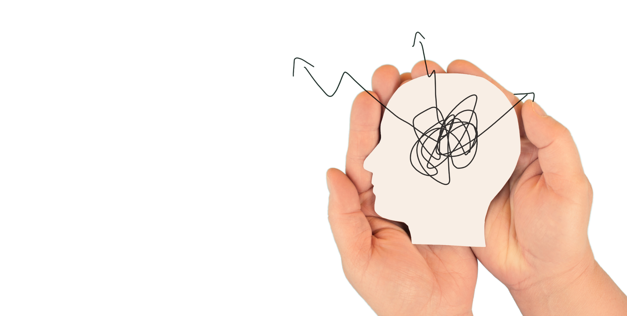
1
INTRODUCTION

Slide 3

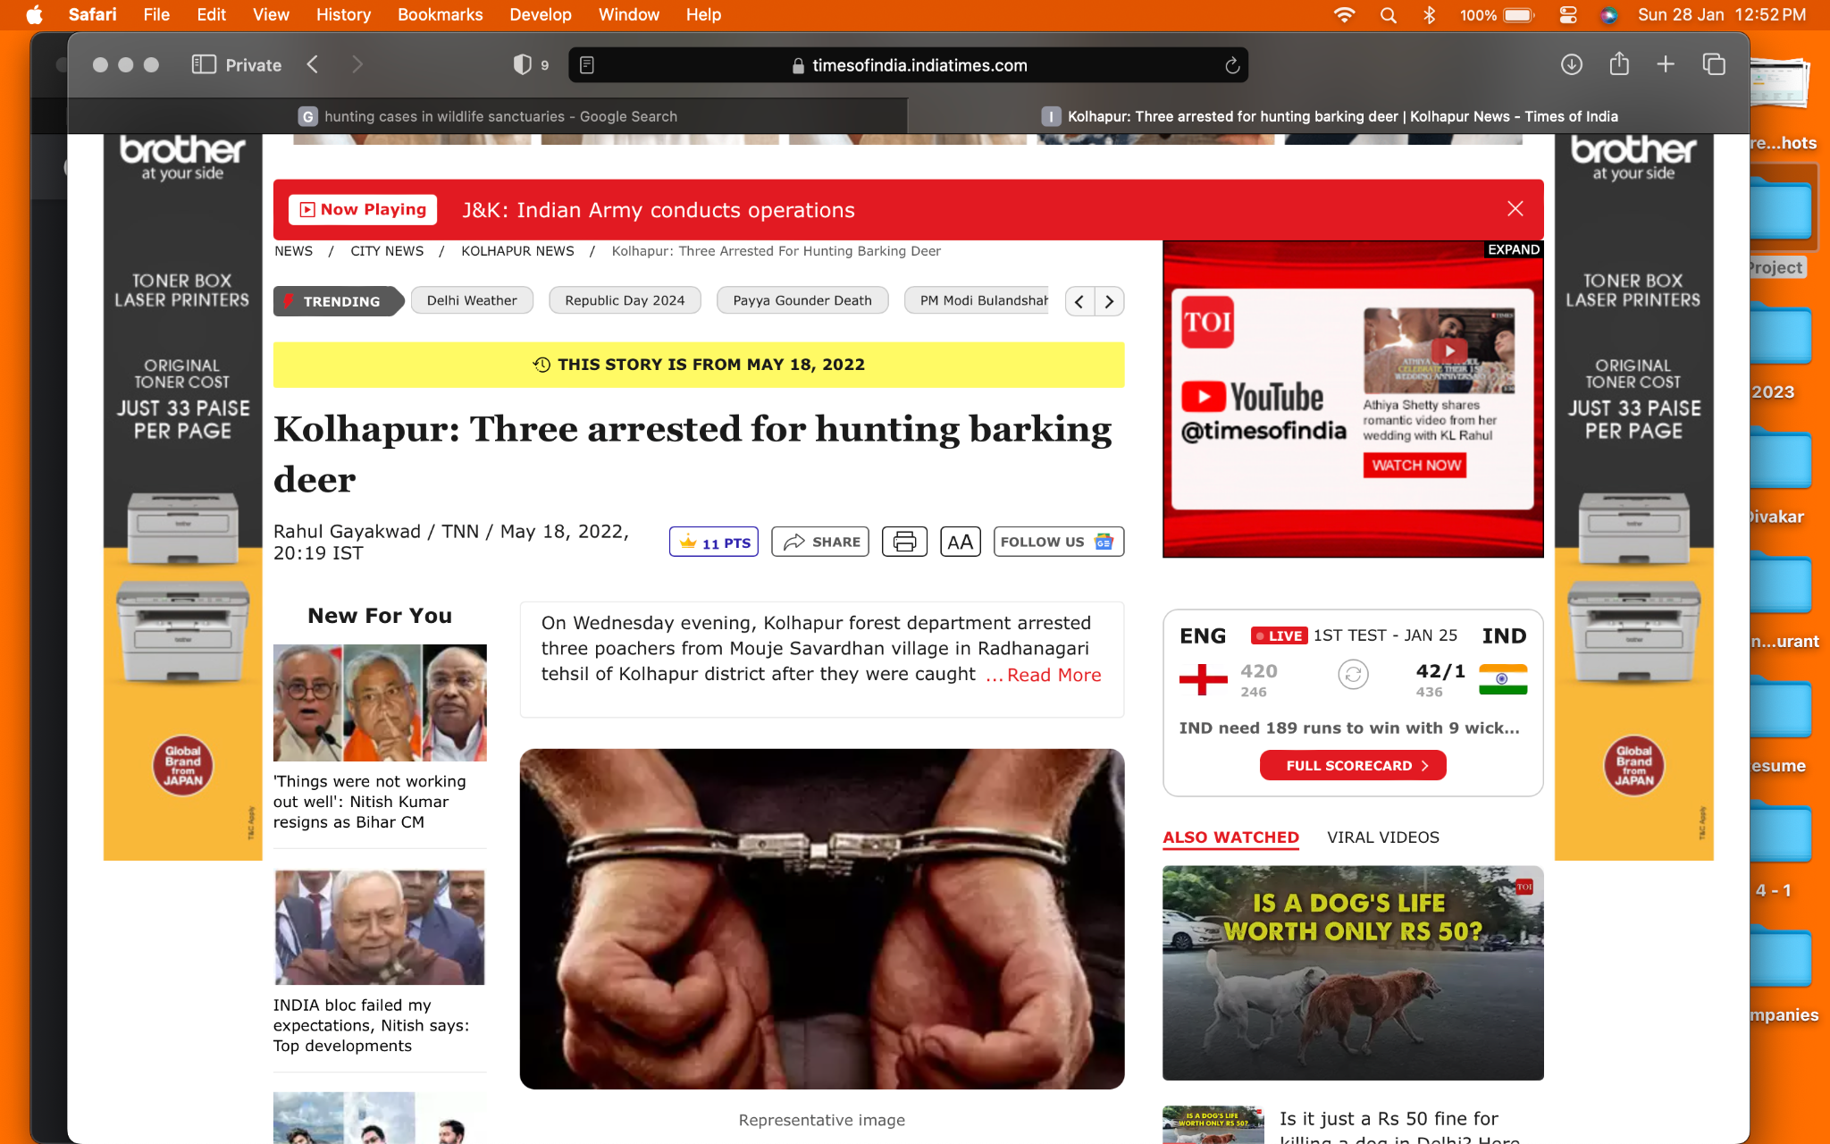
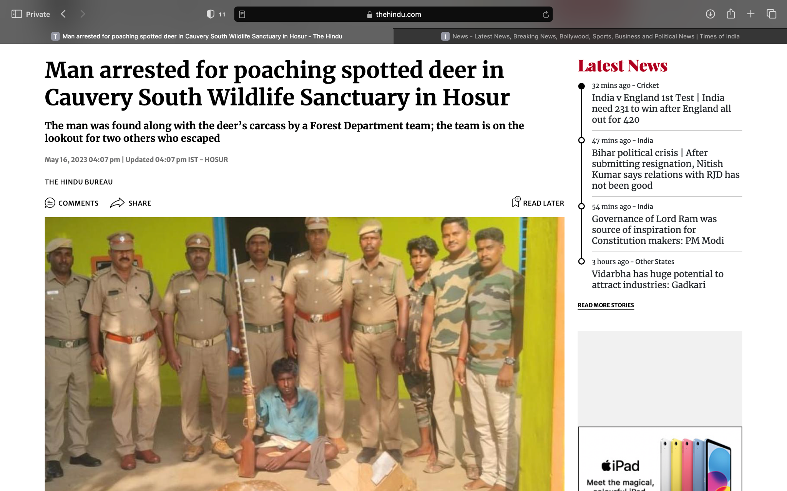
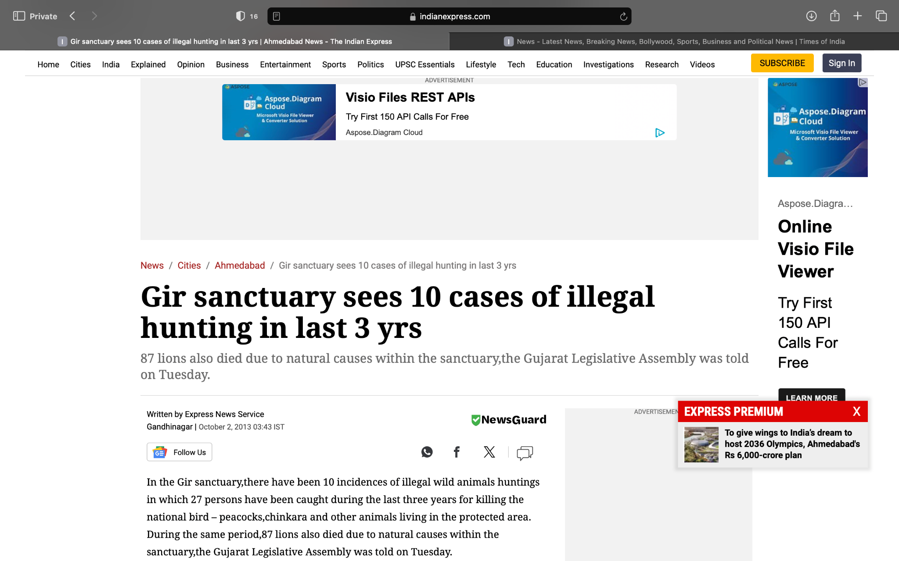
All the undomesticated animals comes under wildlife.
Many wildlife sanctuaries were established in order to protect these wildlife from hunger, shelter and hunting.
Even though sanctuaries were guarded with rangers, the poaching activities continued.
There were guards who are allowing illegal activities in exchange for some ransom.

Slide 4

Automated Poaching Detection
Objectives
Alert Creation
Sending the alert to concern departments

Slide 5



3
Architecture and Flowchart

Slide 6
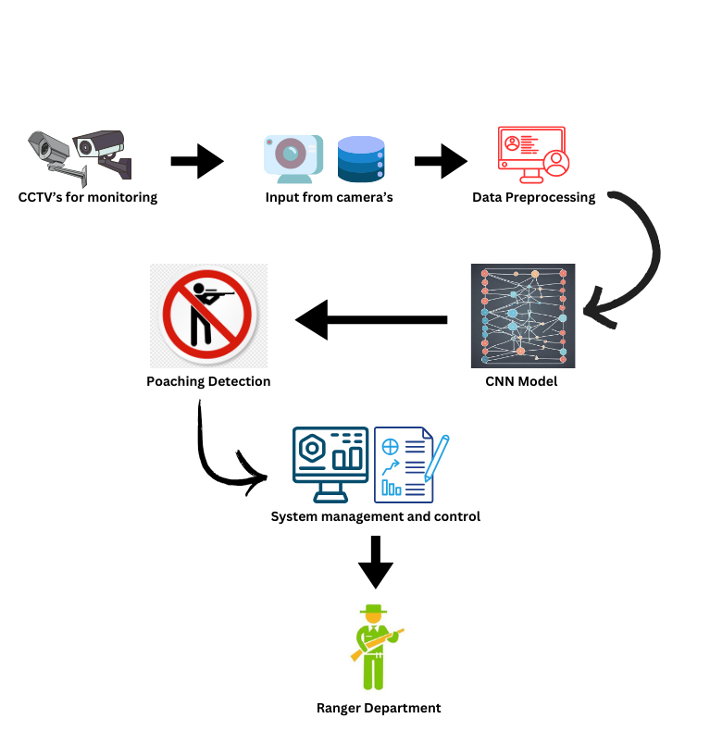

Slide 7
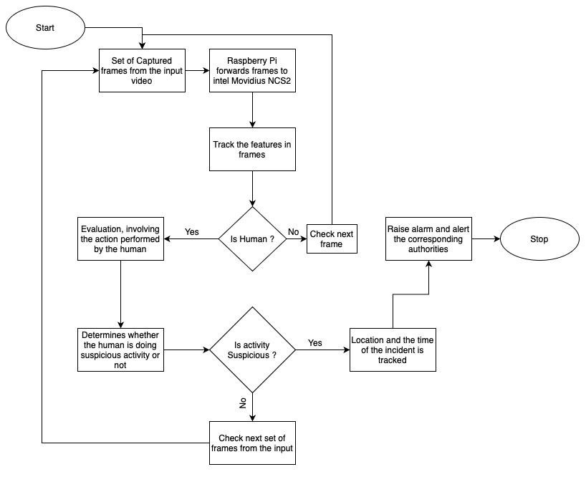

Slide 8
4
Dataset Preparation

Slide 9
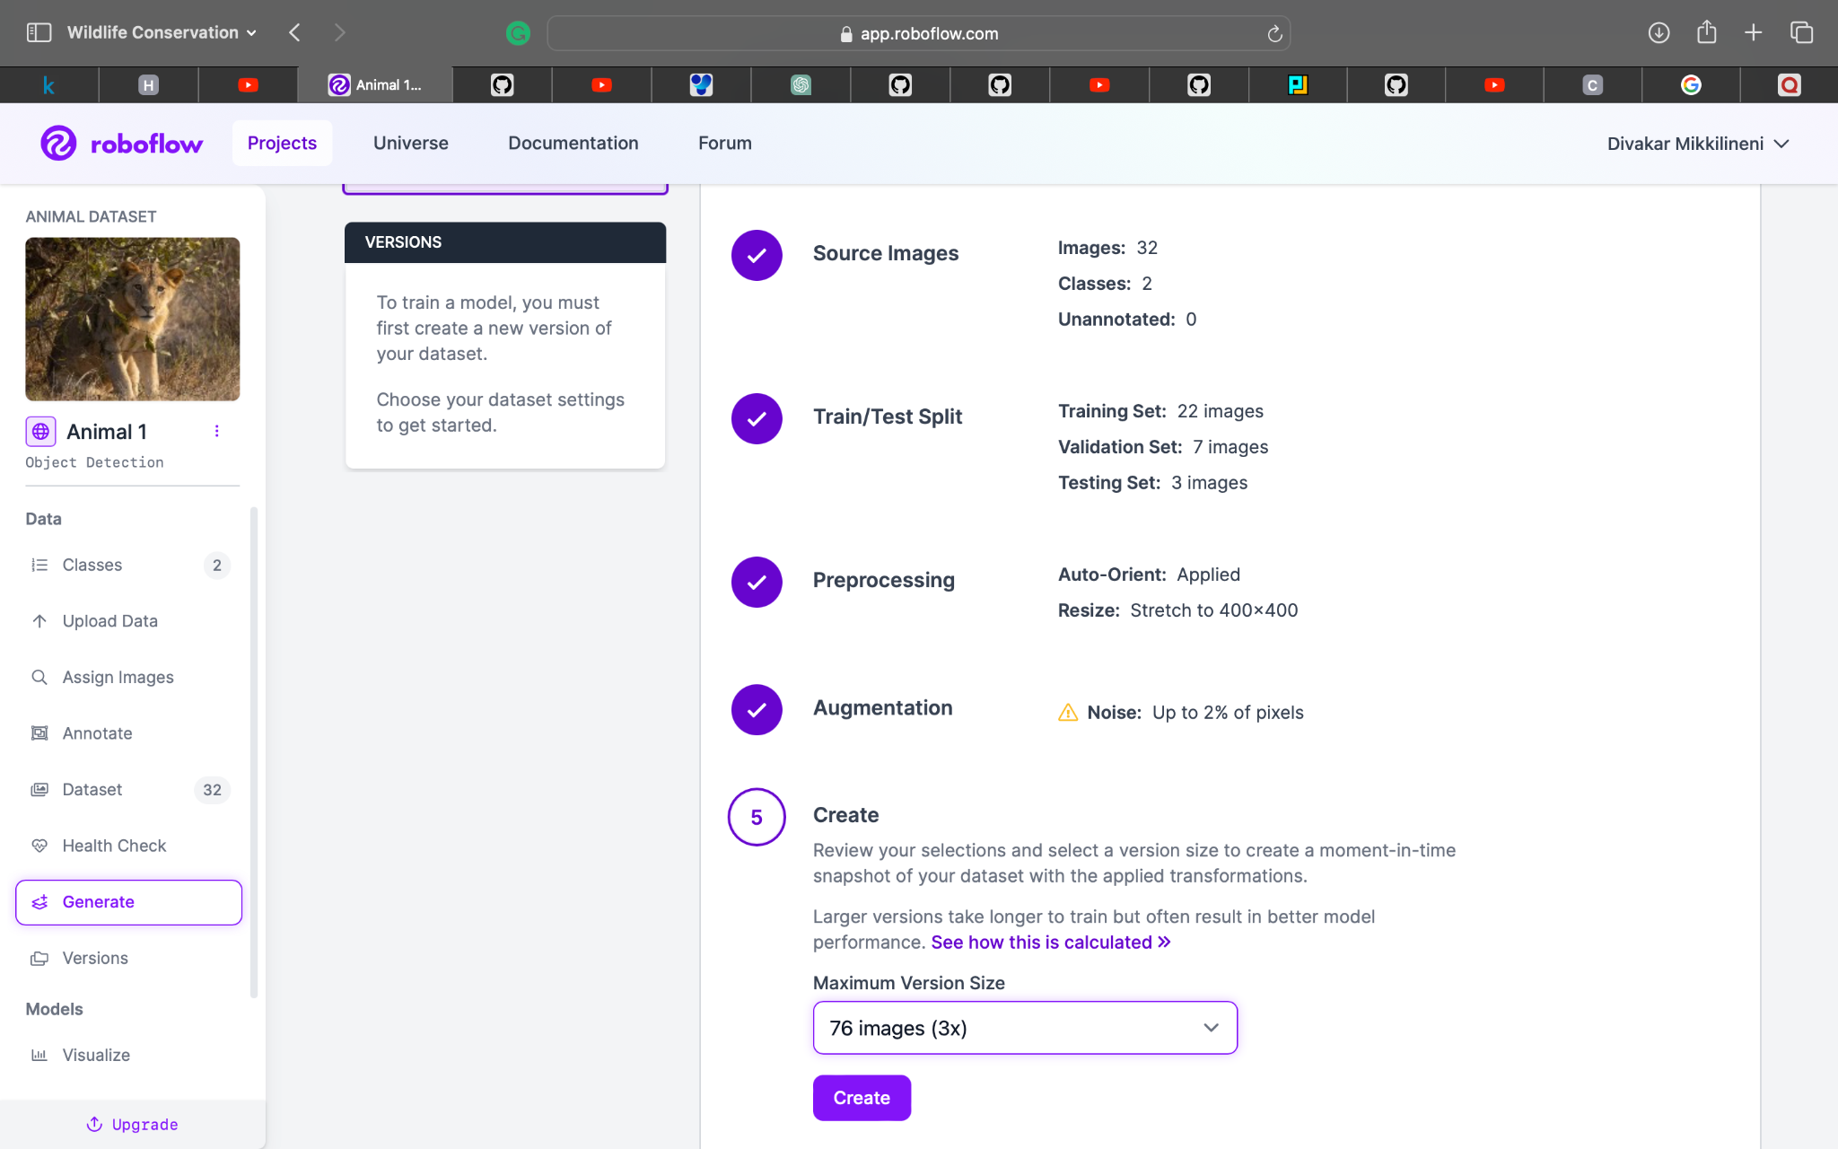
Dataset Preparation
Data Collection
Annotation/Labelling
Collected data from different sources for training and testing
Annotated the whole data by using roboflow
Resizing of data
Data Augmentation
All the image data was resized to 400 X 400 pixel size
Augmented the data by adding a noise upto 2% of pixels

Slide 10
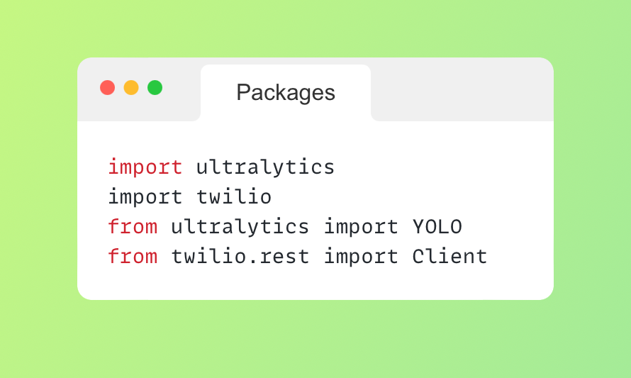

Slide 11
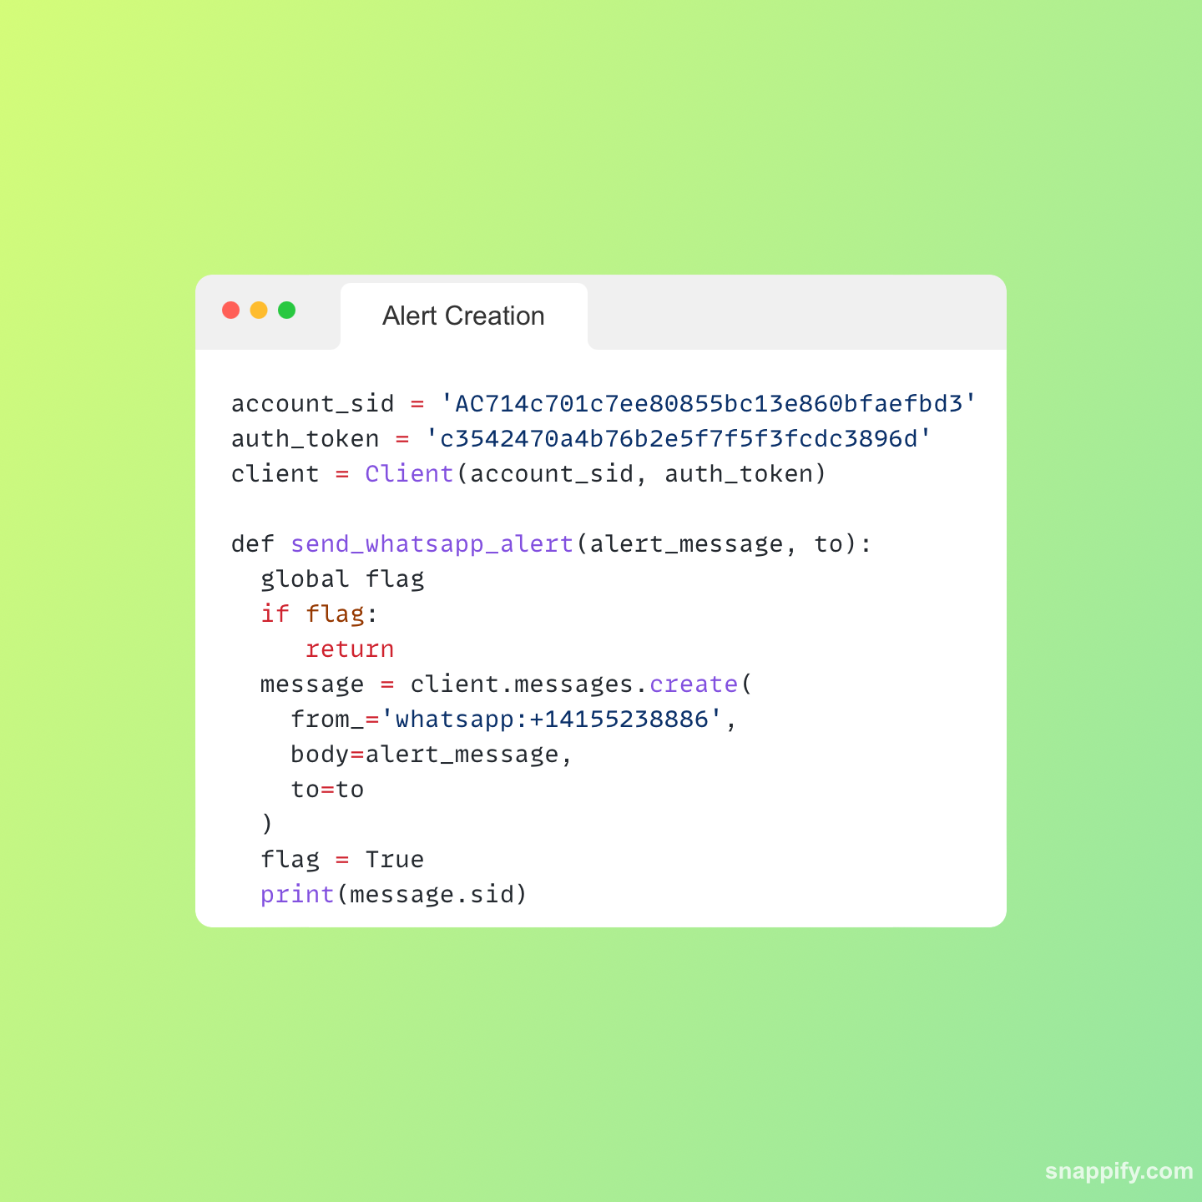
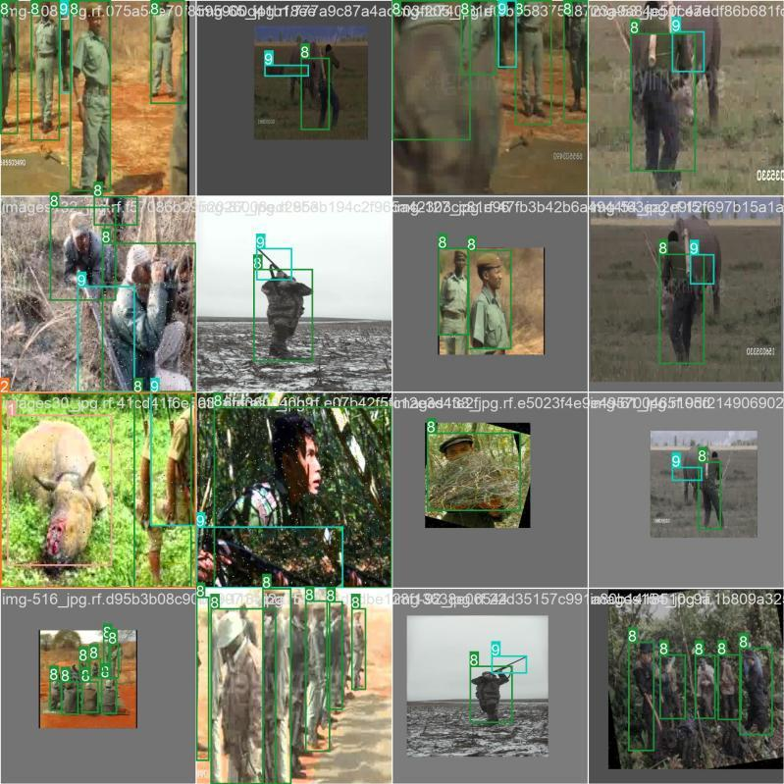

Slide 12


Slide 13
Conclusion and Future Scope
To maintain the balance in the ecosystem and thus to protect the wildlife from the fear of being hunted, data that is collected from the camera traps or live streams of a camera is provided to the proposed model as input after the application of preprocessing steps on the data and then the model continues with its job i.e. object detection, classification and then alert creation.
Various improvements and modifications to the proposed model such as training the model to even detect gunshot sounds to improve its detection capacity will be worked on in the the next version of the model.

Slide 14


